Slide 1
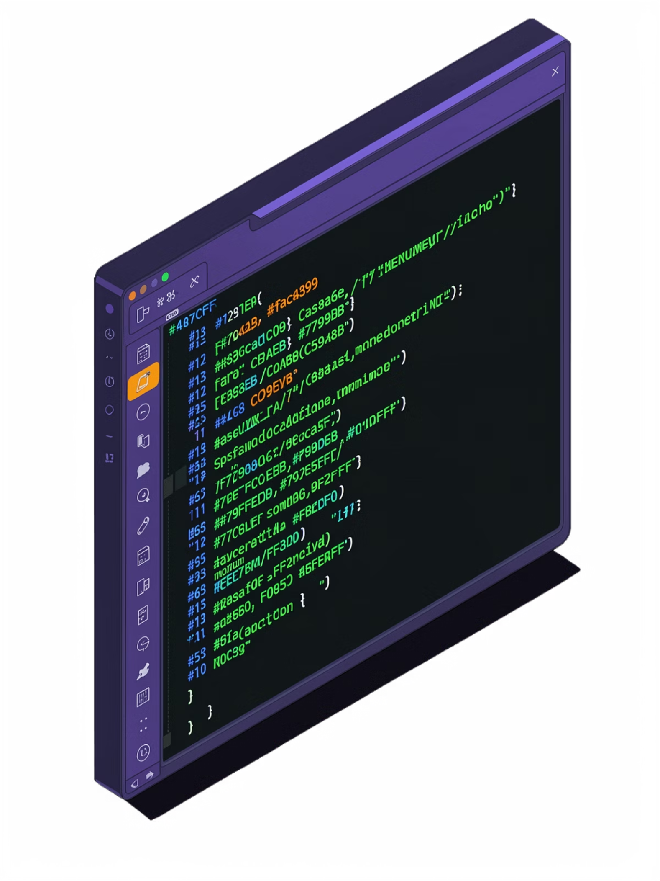
SHELLX – Student Linux Toolkit
Final Project Review | OSSP
Problem
Solution
Linux utilities scattered; steep learning curve for beginners
Unified, menu-driven terminal toolkit in C for Linux/Ubuntu
Outcome
Lightweight, modular app — file management, system info, notes, calculator & more

Slide 2


Problem, Objective & Solution
Problem
Objective
Solution
Beginners struggle to recall Linux commands; utilities are fragmented across the system with no unified entry point
Build a lightweight C-based toolkit with a simple menu interface, modular architecture, and deep system integration
ShellX unifies file management, command execution, notes, calculations, system info, and password generation in one terminal application

Slide 3

System Architecture & Project Structure
7 Core Modules
File Manager
Command Runner
Notes Manager
Calculator
System Information
Password Generator
Interactive Command Mode
Functional Modules
File manager, runners, utilities, core services
ShellX Menu
Menu dispatcher and UI (ANSI colors)
Core Shell
User input and interactive command mode
Utilities & Build
UI (ANSI colors) · Logger · Validator
Modular .c/.h files · Makefile automation · GCC compilation

Slide 4
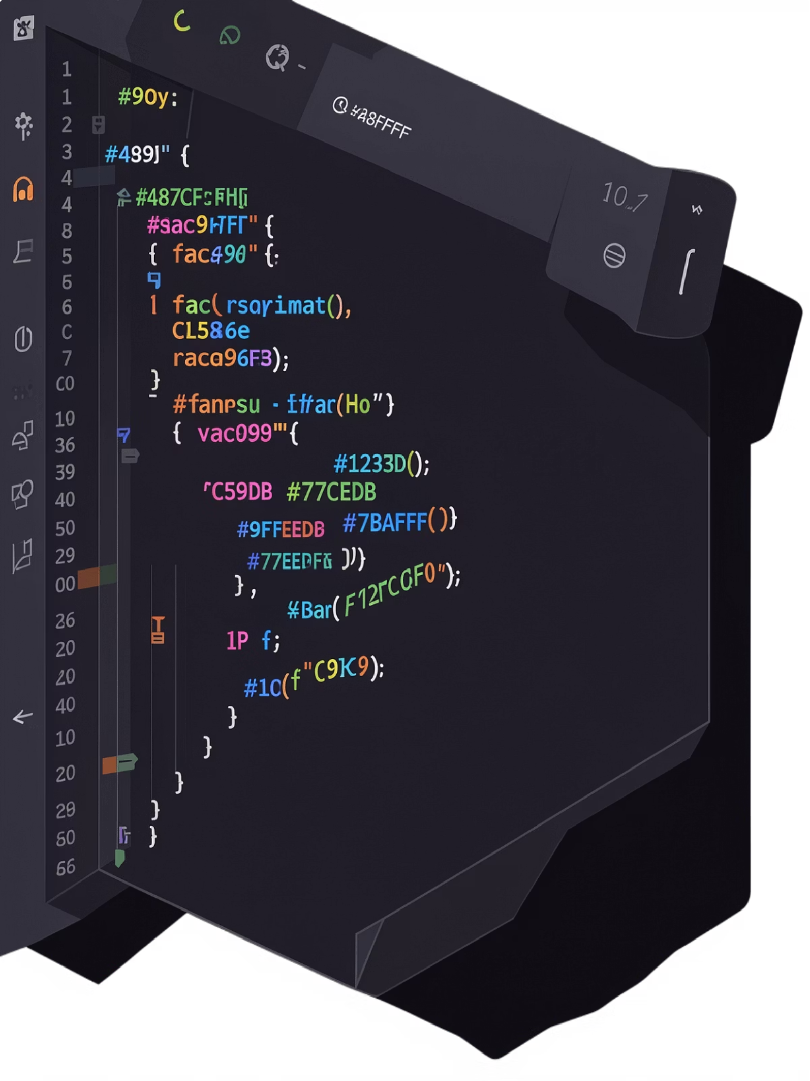




Implementation & Technical Competence
Core Techniques
Modular C programming, switch-case menu control, input validation loops, file I/O via fopen, fprintf, fgets
System Integration
Linux commands via system(), random password generation, ANSI escape sequences for terminal UI
Data Persistence
Text-file storage for notes; Makefile-driven compilation pipeline
Error Handling
Division-by-zero validation, input bounds checking, file operation error detection

Slide 5

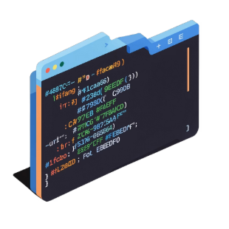


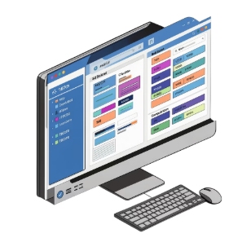

Features & User Experience
📁 File Manager
🖥 Command Runner
📝 Notes Manager
🧮 Calculator
Create, delete, list, rename files directly from the menu
Run ls, pwd, whoami, date with one keypress
Add, view, delete notes with persistent file-based storage
Arithmetic operations with full input validation and edge-case handling
📊 System Info
🔐 Password Generator
User, directory, date, memory, and disk status at a glance
Custom-length alphanumeric passwords; ⚡ Interactive Command Mode for direct Linux execution

Slide 6
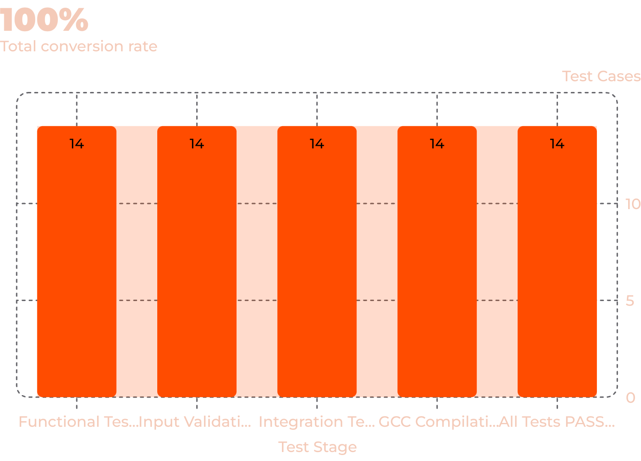


Testing, Accuracy & Results
1
2
14/14 Passed
File Operations
All test cases passed across every module
Create, delete, rename, list — all verified
3
4
Edge Cases
Command Execution
Division-by-zero caught; notes persistence confirmed
All system calls tested across integrated modules

Slide 7
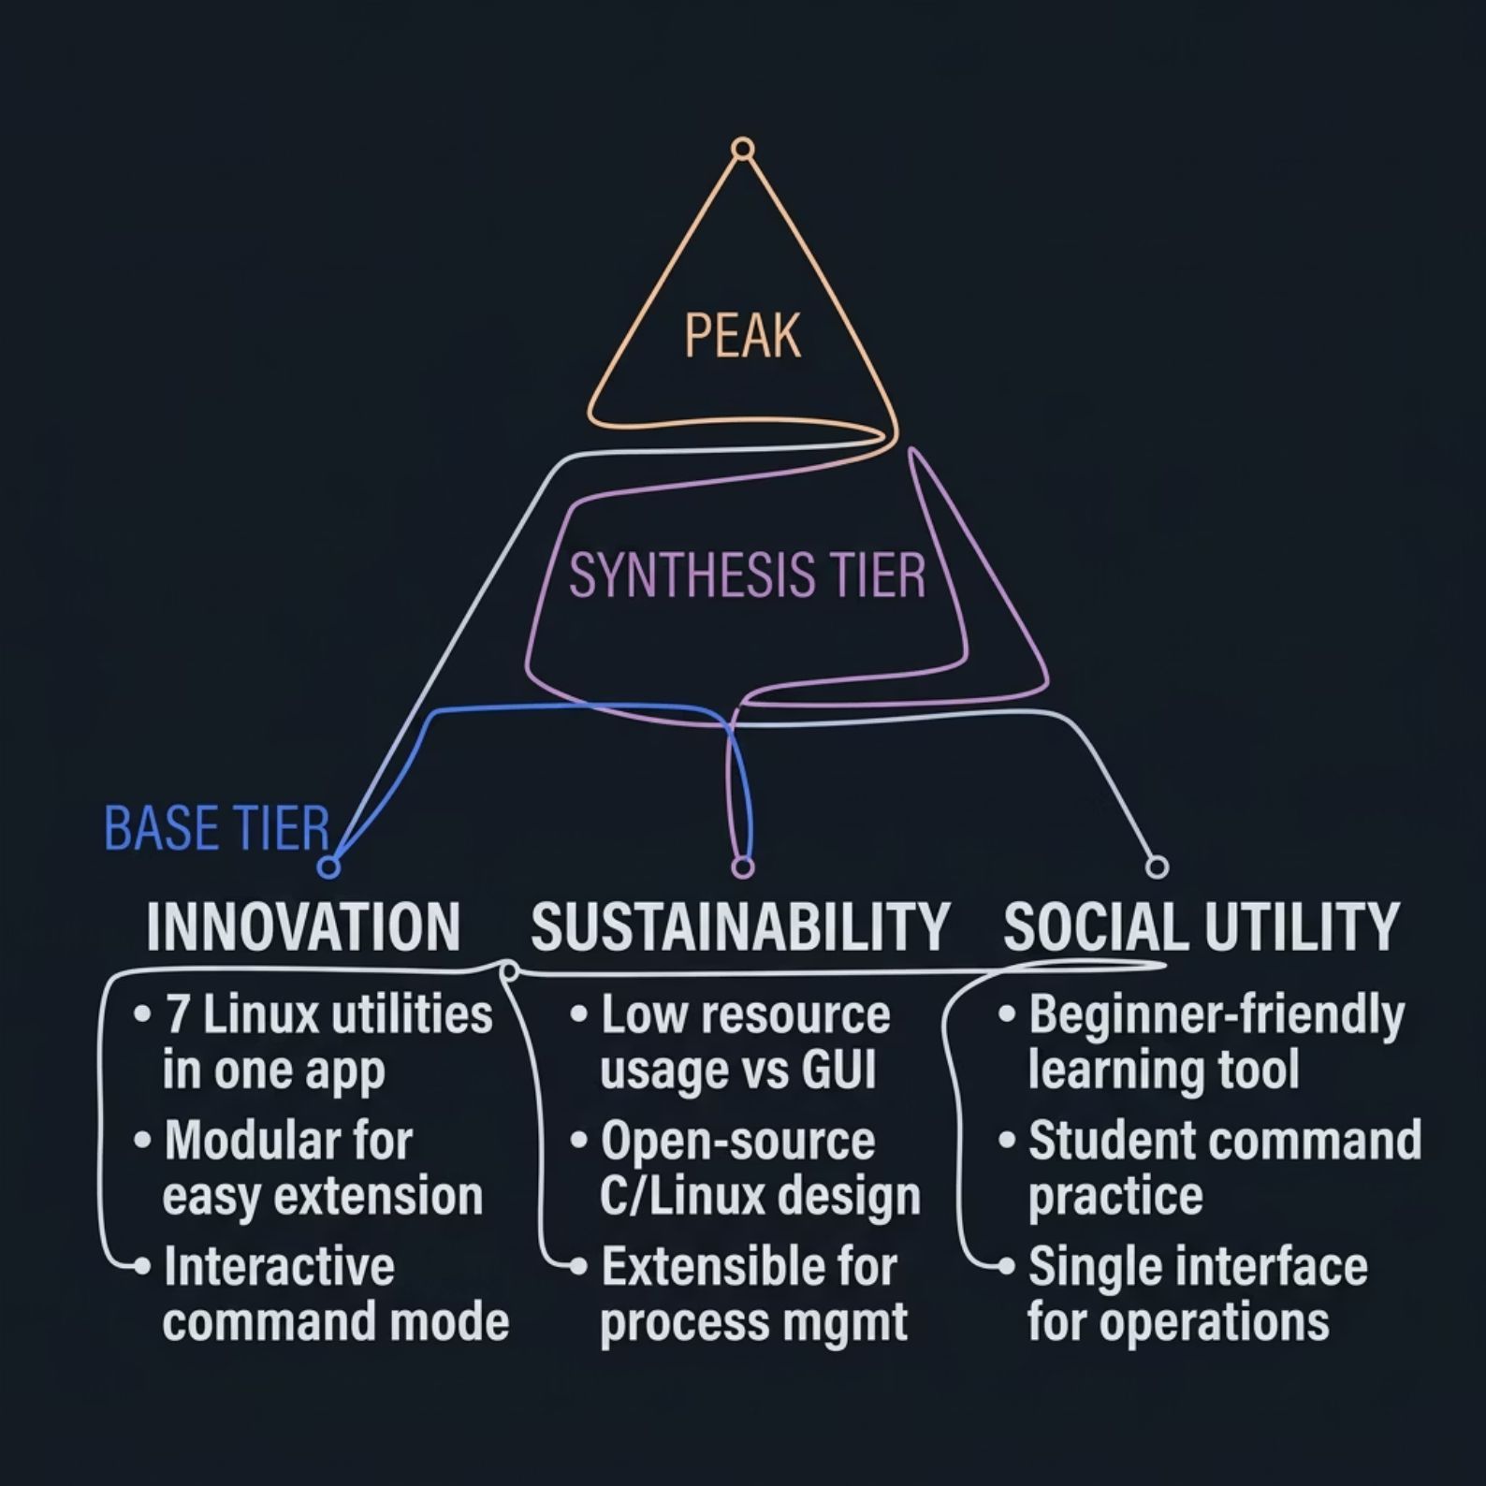
Innovation, Sustainability & Social Utility
Innovation
7 Linux utilities unified in one lightweight app. Modular architecture enables easy maintenance and extension. Interactive Command Mode bridges ShellX with native Linux.
Sustainability
Minimal resource footprint vs. GUI alternatives. Open-source-friendly C/Linux design. Extensible for ncurses UI, command history, file search, and process management.
Social Utility
Beginner-friendly Linux learning tool. Single interface for common operations. Extensible for educational labs and Linux training environments.

Slide 8

Conclusion & Future Scope
Key Achievements
Impact
✓ Modular C architecture & 7 functional modules
Demonstrates C programming, Linux system interaction, modular design, and user-oriented terminal interfaces — combined into a practical educational toolkit.
✓ Linux system integration via system()
Future Scope
✓ Persistent file-based notes & terminal UI
ncurses-based graphical terminal UI
Command history & file/notes search
Process manager & system dashboard
Additional Linux utility integrations
✓ Full input validation, error handling & 14/14 tests passed

